Slide 1

Plume sketch
C₂H₂ source
wind
C₂H₂ obs.
α
street
plume

Slide 2
Plume geometry
(0,0)
α₂
(x_{c},y_{c})
α
α₁
street
plume

Slide 3
Plume flux
source
Vertical plane along transect
1 m
1 m
street
wind
90°-α

Slide 4
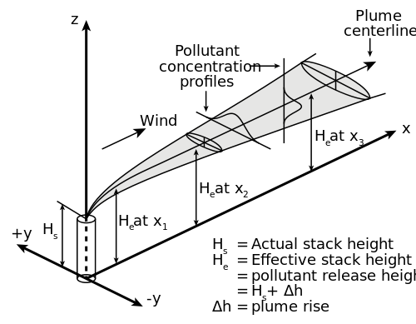

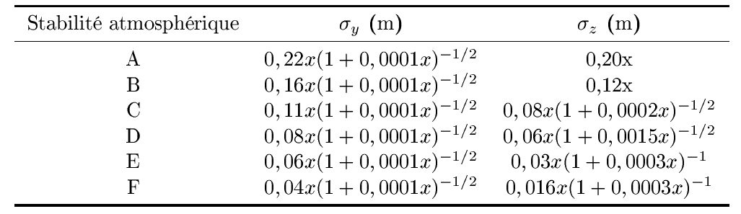
Plume flux
Parameterization following Briggs (1973)

